Slide 1
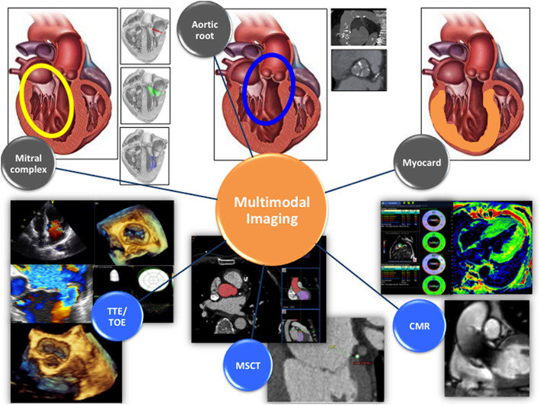
The role of cardiac imaging in decision-making in end-stage heart failure patients
Doç. Dr. Ali Nazmi Çalık
SBÜ, Siyami Ersek Göğüs Kalp ve Damar Cerrahisi EAH
PCRonline Editorial Board
EAPCI Online & Communication Committee
@ANazmiCalik
@ANazmiCalik

Slide 2
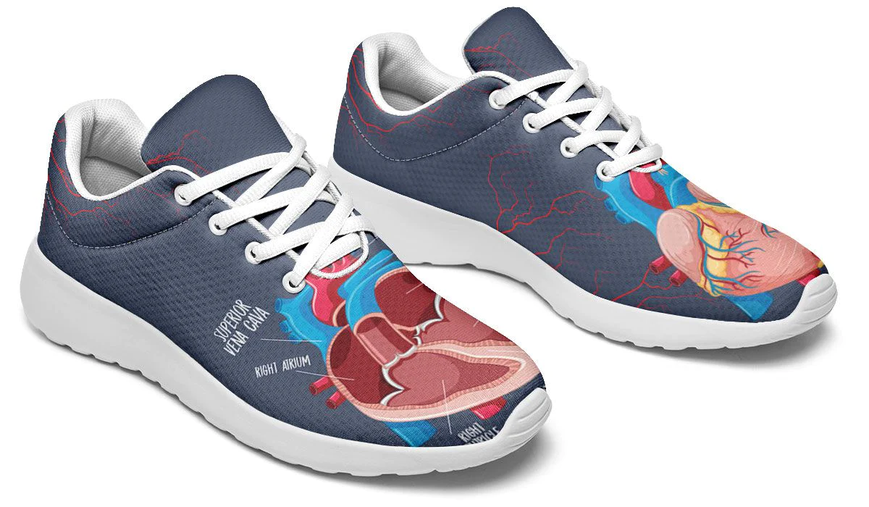
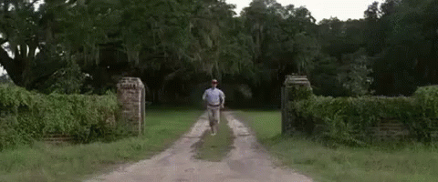
Why is it important?
Invasive cardiologist
Imaging expert
@ANazmiCalik

Slide 3
Why is it important?
Heart failure with reduced ejection fraction (HFrEF) is a major public health challenge.
The prevalence of HF in the developed world approximates 1–2% of the adult population, rising to >10% in those aged >75 years.
Prevalence > 5.8 million patients in the USA and over 26 million worldwide.
Patients with end-stage HFrEF have an estimated 1-year survival of approximately 50%.
Despite up-titrated medical treatment, the therapeutic options are highly limited.
@ANazmiCalik

Slide 4
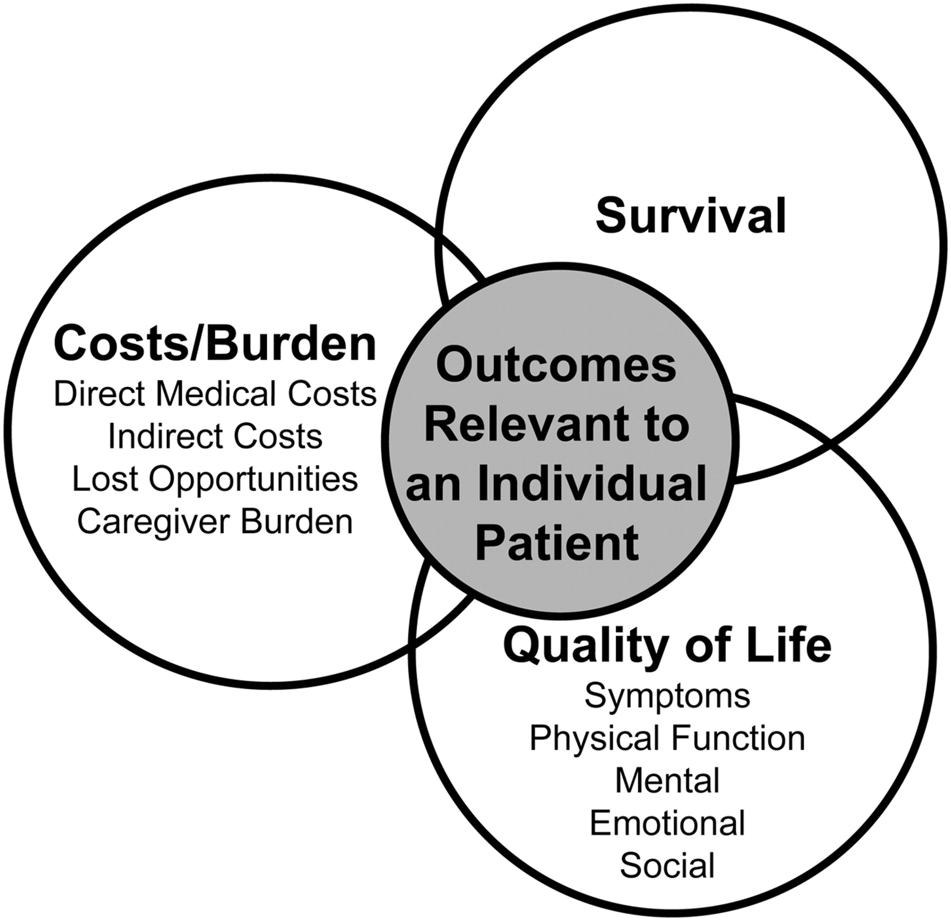
AHA Scientific Statement
@ANazmiCalik
Allen LA, et al. Decision making in advanced heart failure: a scientific statement from the American Heart Association.
Circulation. 2012 Apr 17;125(15):1928-52. doi: 10.1161/CIR.0b013e31824f2173.

Slide 5
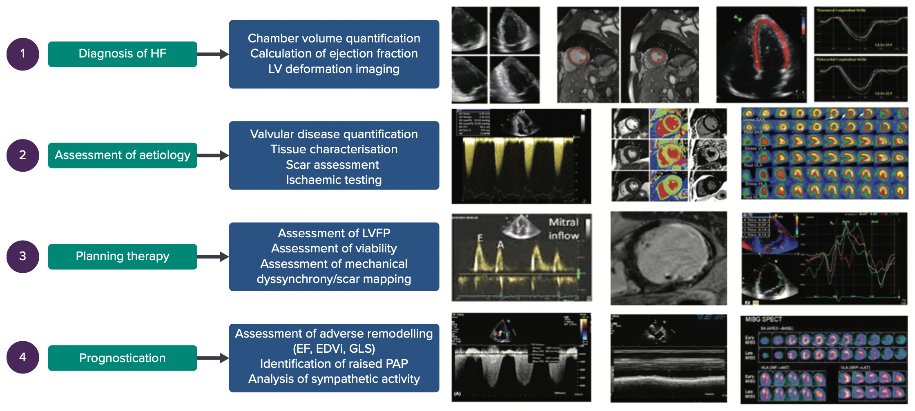
The role of imaging in HFrEF
@ANazmiCalik
Gosling RC, Al-Mohammad A. The Role of Cardiac Imaging in Heart Failure with Reduced Ejection Fraction. Card Fail Rev. 2022 Jun 24;8:e22.

Slide 6
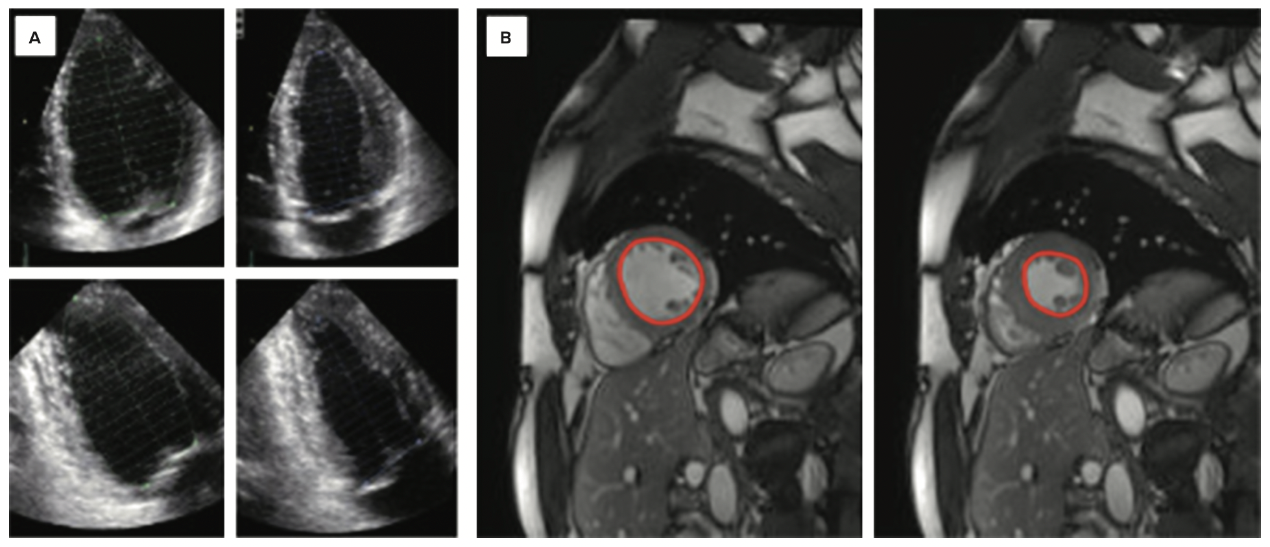
1
1) Diagnosis of HF
Accurate estimation of LVEF remains the cornerstone of HFrEF diagnosis
2D TTE remains the initial modality recommended for the assessment of LVEF.
Advanced imaging techniques,
3D echocardiography
Speckle tracking
Cardiac MRI (CMR)
Nuclear imaging techniques.
@ANazmiCalik
Gosling RC, Al-Mohammad A. The Role of Cardiac Imaging in Heart Failure with Reduced Ejection Fraction. Card Fail Rev. 2022 Jun 24;8:e22.

Slide 7
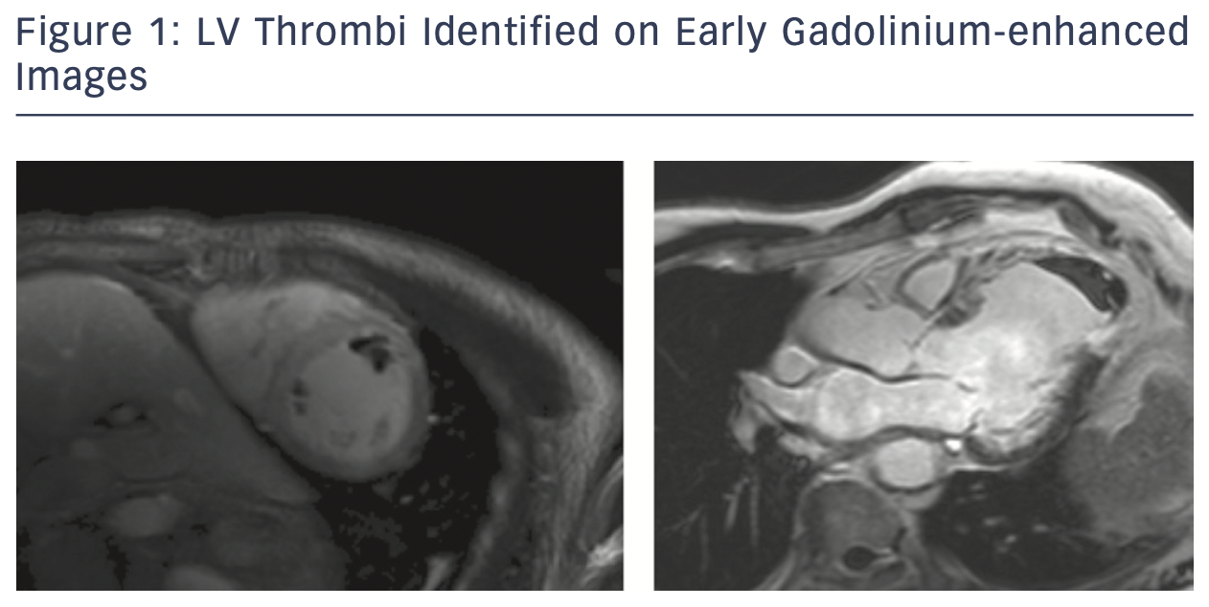
2) Assessment of aetiology
TTE assessment
Valvular disease
RWMA
LVH
CMR with tissue characterization
@ANazmiCalik
Peterzan MA, Rider OJ, Anderson LJ. The Role of Cardiovascular Magnetic Resonance Imaging in Heart Failure.
Card Fail Rev. 2016 Nov;2(2):115-122. doi: 10.15420/cfr.2016.2.2.115.

Slide 8
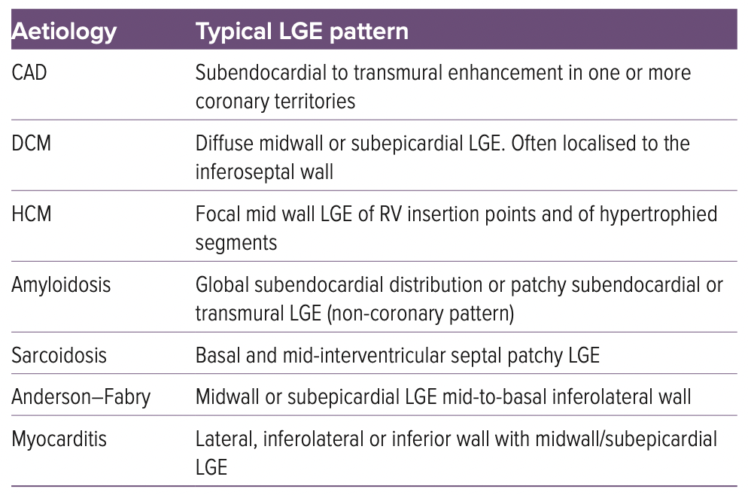
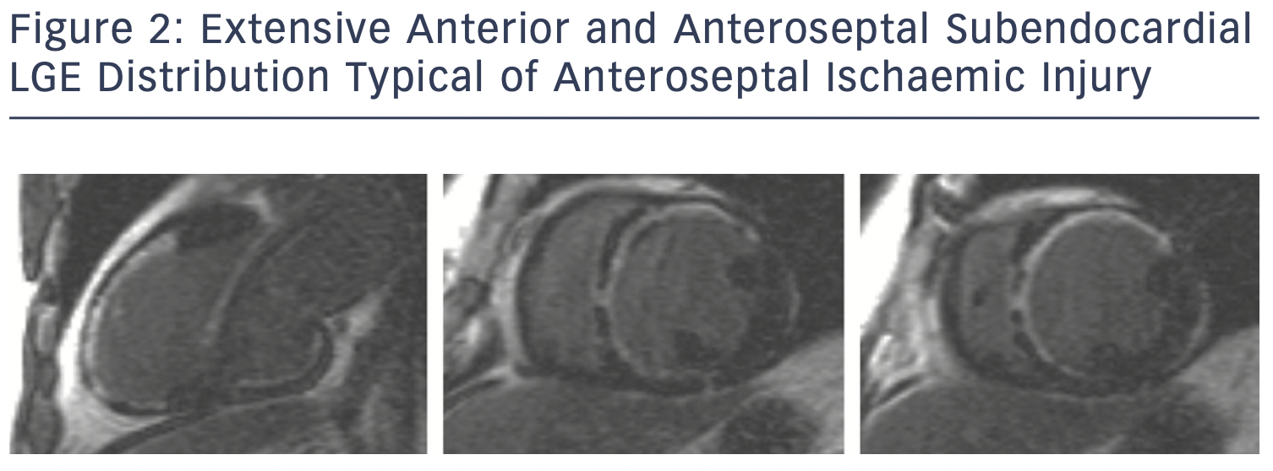
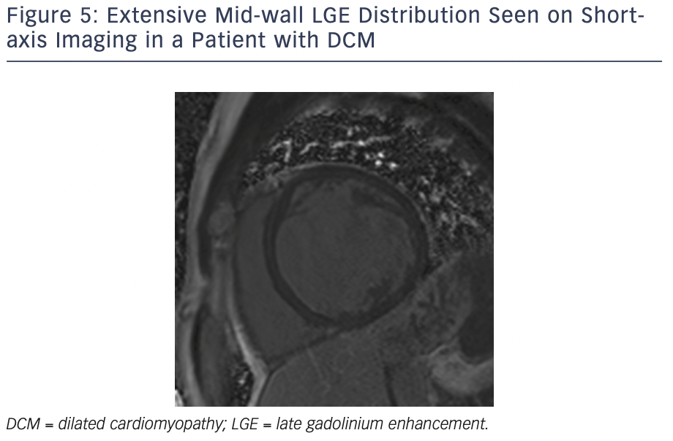
2) Assessment of aetiology
@ANazmiCalik
Peterzan MA, Rider OJ, Anderson LJ. The Role of Cardiovascular Magnetic Resonance Imaging in Heart Failure.
Card Fail Rev. 2016 Nov;2(2):115-122. doi: 10.15420/cfr.2016.2.2.115.

Slide 9
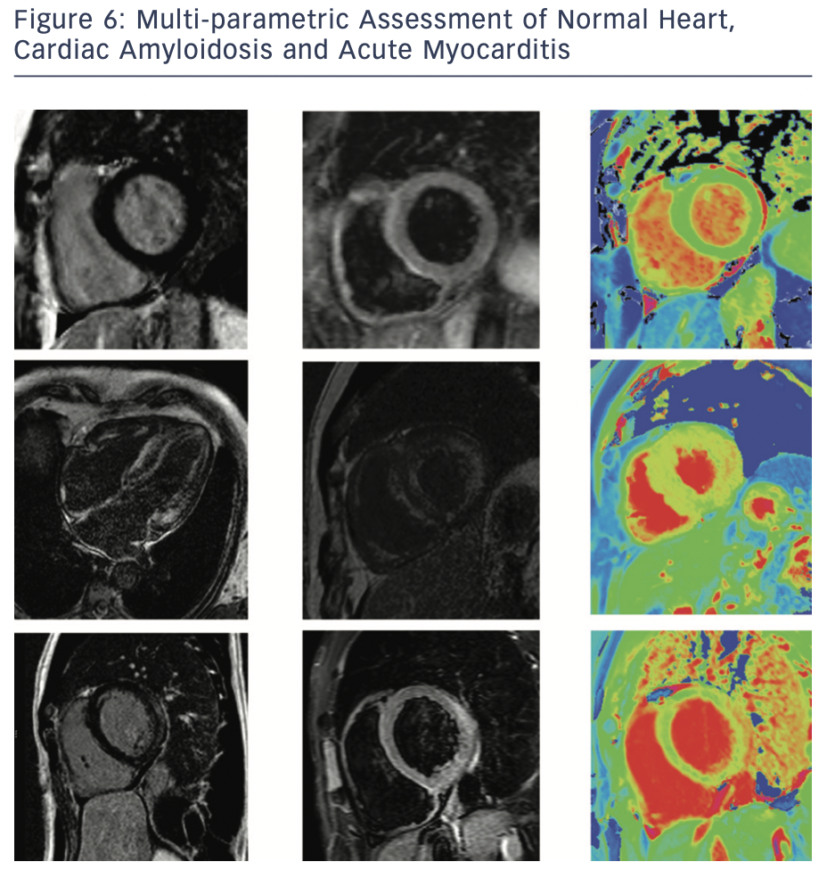
2) Assessment of aetiology
@ANazmiCalik
Peterzan MA, Rider OJ, Anderson LJ. The Role of Cardiovascular Magnetic Resonance Imaging in Heart Failure.
Card Fail Rev. 2016 Nov;2(2):115-122. doi: 10.15420/cfr.2016.2.2.115.

Slide 10
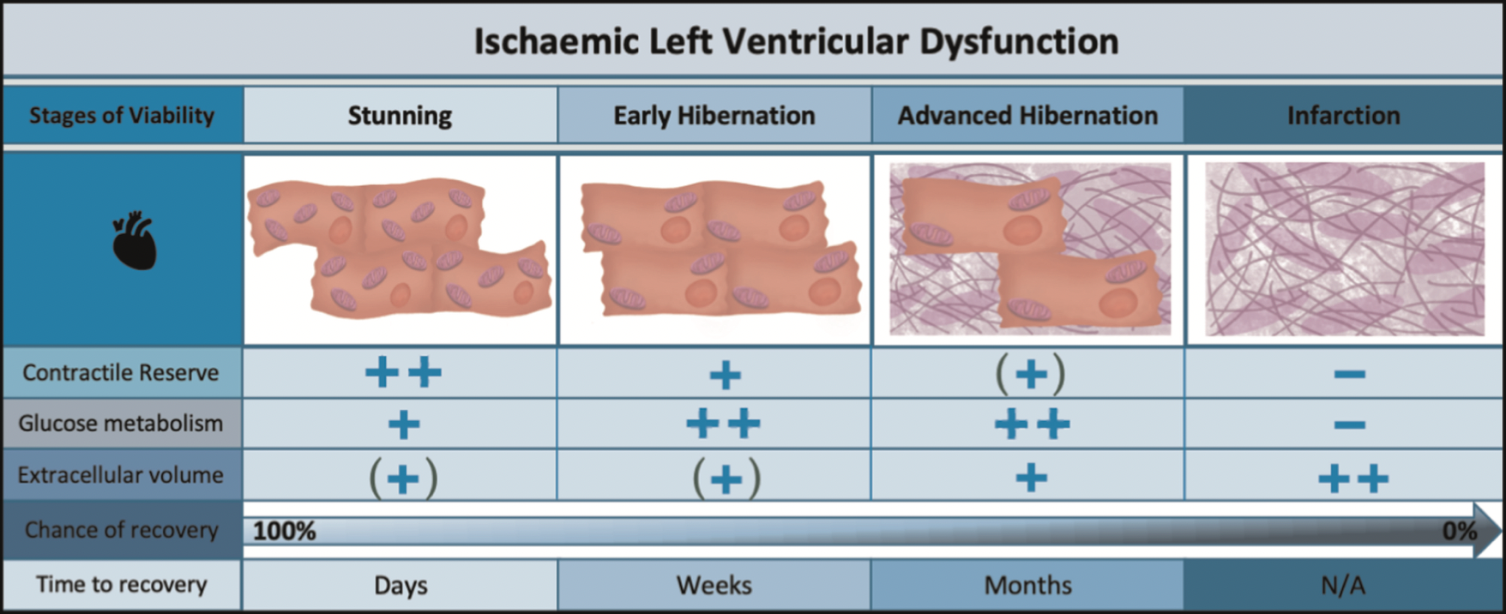
3) Planning therapy
@ANazmiCalik
Ryan M et al. Myocardial viability testing: all STICHed up, or about to be REVIVED?
Eur Heart J. 2022 Jan 13;43(2):118-126. doi: 10.1093/eurheartj/ehab729.

Slide 11
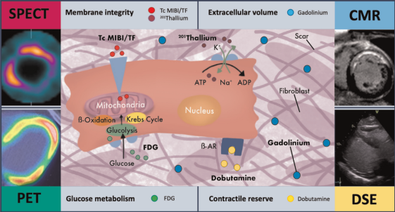
3) Planning therapy
Imaging in Guiding Revascularisation Decision
Ischemia and Viability is key!
Dobutamine stress echo
SPECT with Tl-201 or Tc-99
labelled tracers
PET - gold standard for the assessment of viability using metabolic tracers
CMR
@ANazmiCalik
Ryan M et al. Myocardial viability testing: all STICHed up, or about to be REVIVED?
Eur Heart J. 2022 Jan 13;43(2):118-126. doi: 10.1093/eurheartj/ehab729.

Slide 12
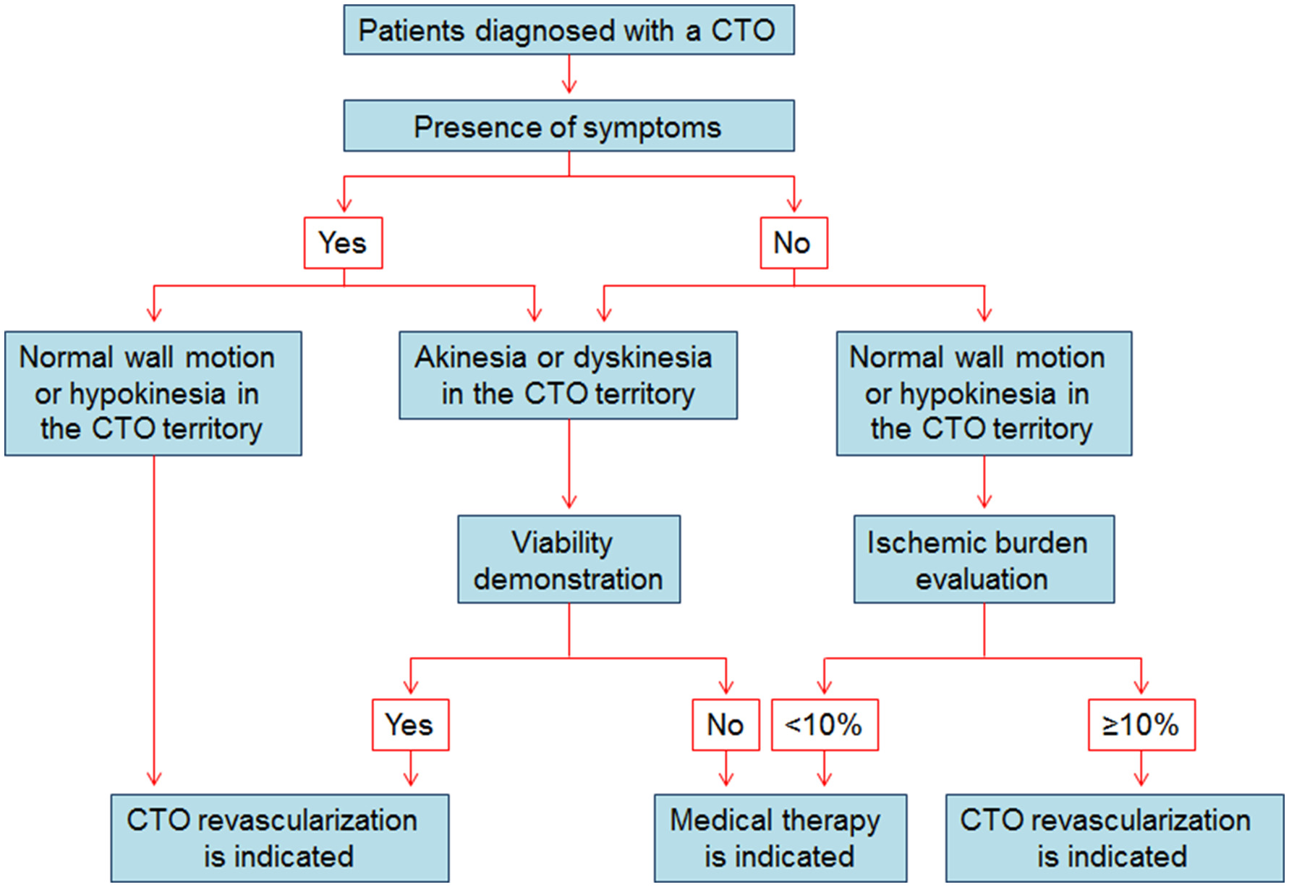
3) Planning therapy
Imaging in Guiding Revascularisation Decision
Ischemia and Viability is key!
Dobutamine stress echo
SPECT with Tl-201 or Tc-99
labelled tracers
PET - gold standard for the assessment of viability using metabolic tracers
CMR
@ANazmiCalik
Schumacher SP et al. Percutaneous Coronary Intervention of Chronic Total Occlusions: When and How to Treat.
Cardiovasc Revasc Med. 2019 Jun;20(6):513-522. doi: 10.1016/j.carrev.2018.07.025.

Slide 13
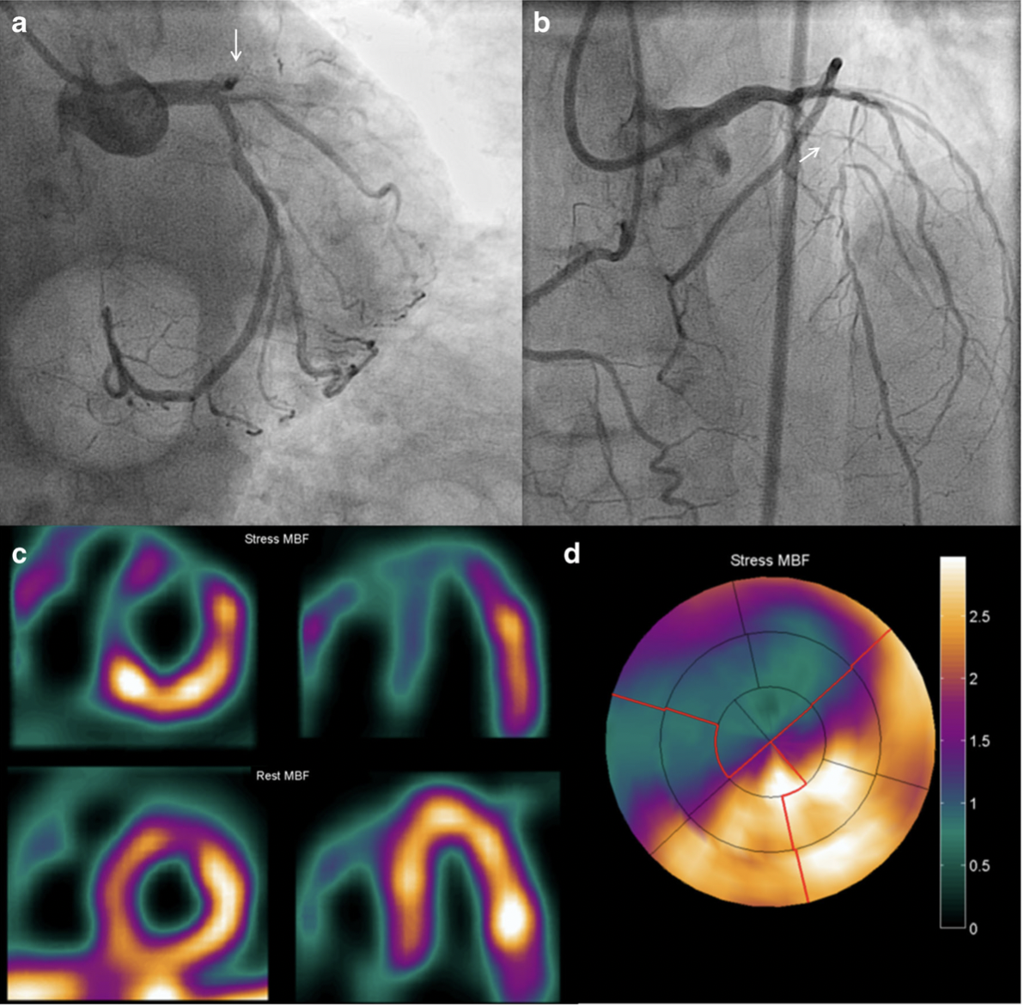
3) Planning therapy
Imaging in Guiding Revascularisation Decision
Ischemia and Viability is key!
PET - gold standard for the assessment of viability using metabolic tracers
@ANazmiCalik
Stuijfzand WJ, et al. Value of Hybrid Imaging with PET/CT to Guide Percutaneous Revascularization of Chronic Total Coronary Occlusion.
Curr Cardiovasc Imaging Rep. 2015;8(7):26. doi: 10.1007/s12410-015-9340-2.

Slide 14
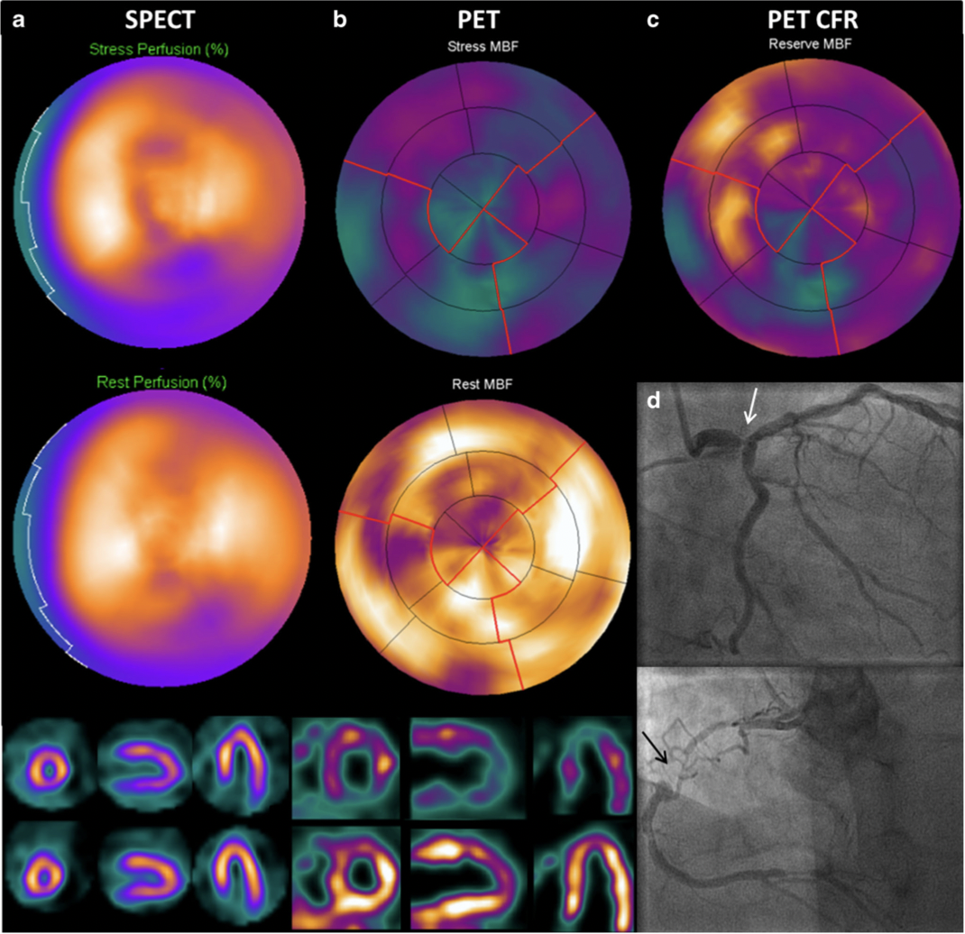
3) Planning therapy
Imaging in Guiding Revascularisation Decision
Hybrid imaging!!!
SPECT with Tl-201 or Tc-99
labelled tracers
PET - gold standard for the assessment of viability using metabolic tracers
@ANazmiCalik
Stuijfzand WJ, et al. Value of Hybrid Imaging with PET/CT to Guide Percutaneous Revascularization of Chronic Total Coronary Occlusion.
Curr Cardiovasc Imaging Rep. 2015;8(7):26. doi: 10.1007/s12410-015-9340-2.

Slide 15
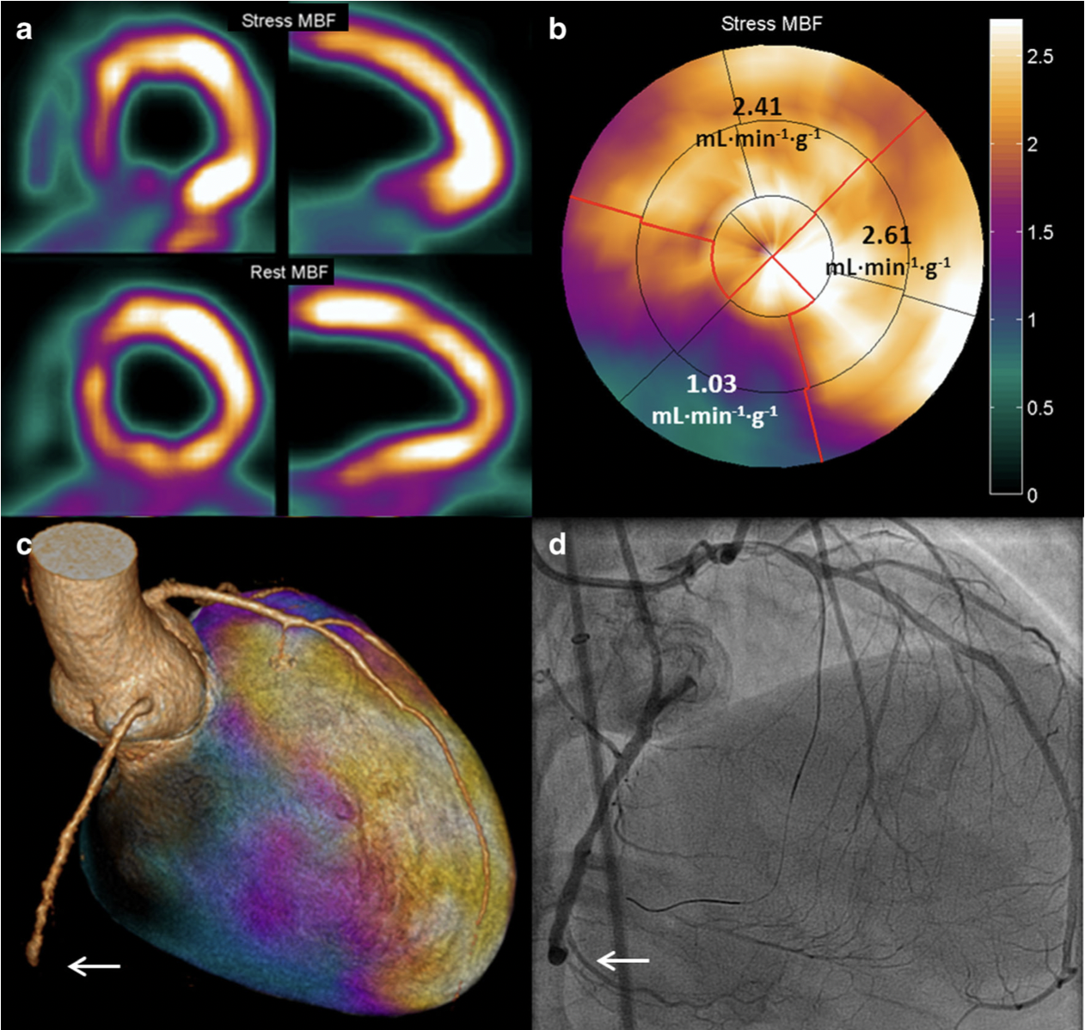
3) Planning therapy
Imaging in Guiding Revascularisation Decision
Hybrid imaging!!!
CCTA
PET - gold standard for the assessment of viability using metabolic tracers
@ANazmiCalik
Stuijfzand WJ, et al. Value of Hybrid Imaging with PET/CT to Guide Percutaneous Revascularization of Chronic Total Coronary Occlusion.
Curr Cardiovasc Imaging Rep. 2015;8(7):26. doi: 10.1007/s12410-015-9340-2.

Slide 16
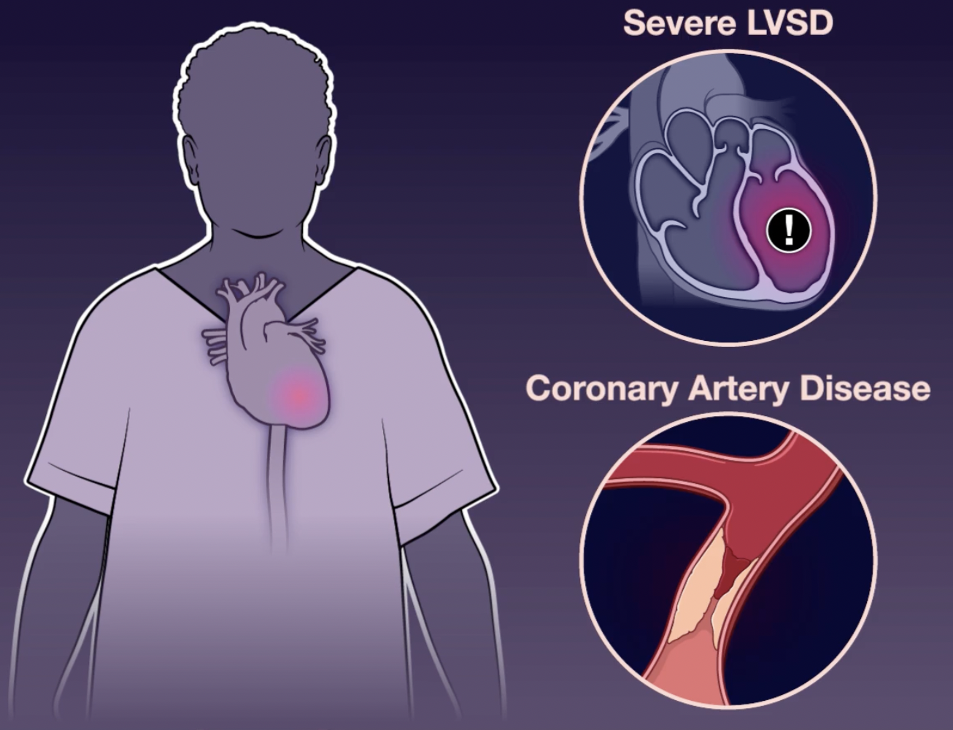
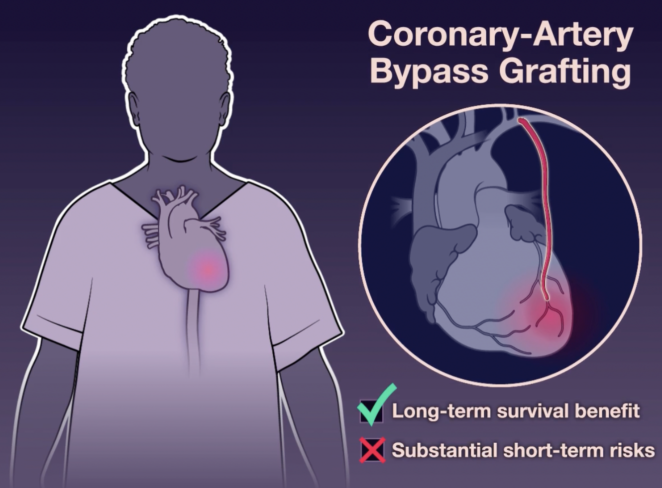
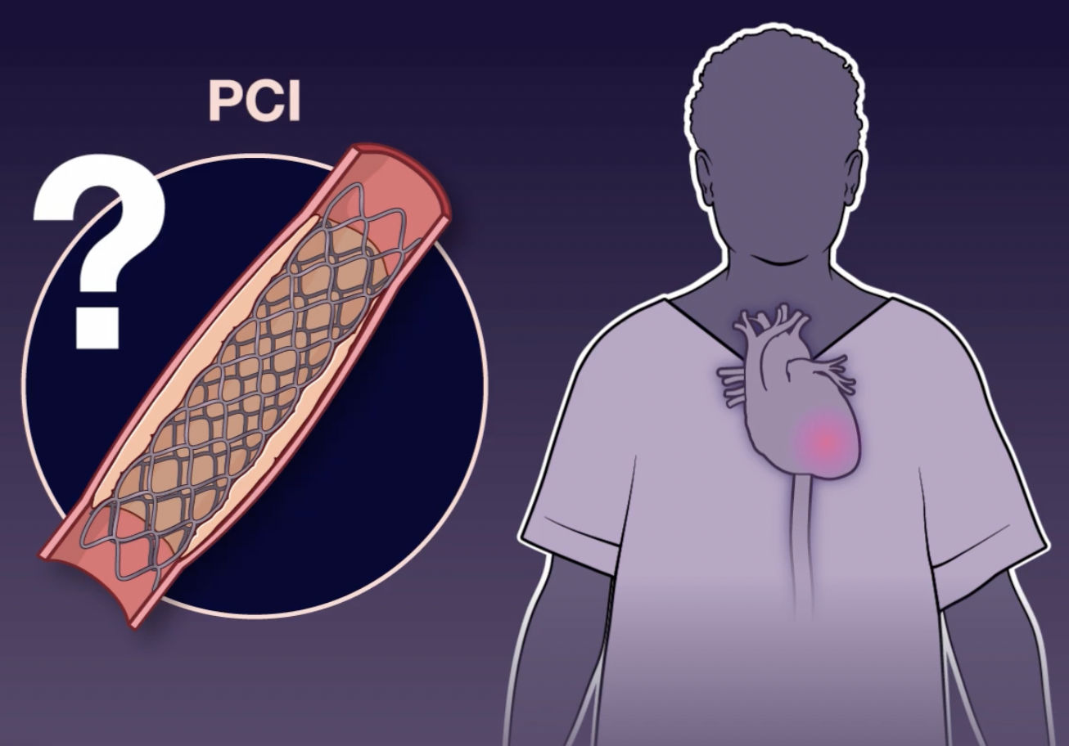
REVIVED-BCIS2 Trial
@ANazmiCalik
Perera D et al. Percutaneous Revascularization for Ischemic Left Ventricular Dysfunction.
N Engl J Med. 2022 Oct 13;387(15):1351-1360. doi: 10.1056/NEJMoa2206606.

Slide 17
REVIVED-BCIS2 Trial
@ANazmiCalik
Perera D et al. Percutaneous Revascularization for Ischemic Left Ventricular Dysfunction.
N Engl J Med. 2022 Oct 13;387(15):1351-1360. doi: 10.1056/NEJMoa2206606.

Slide 18
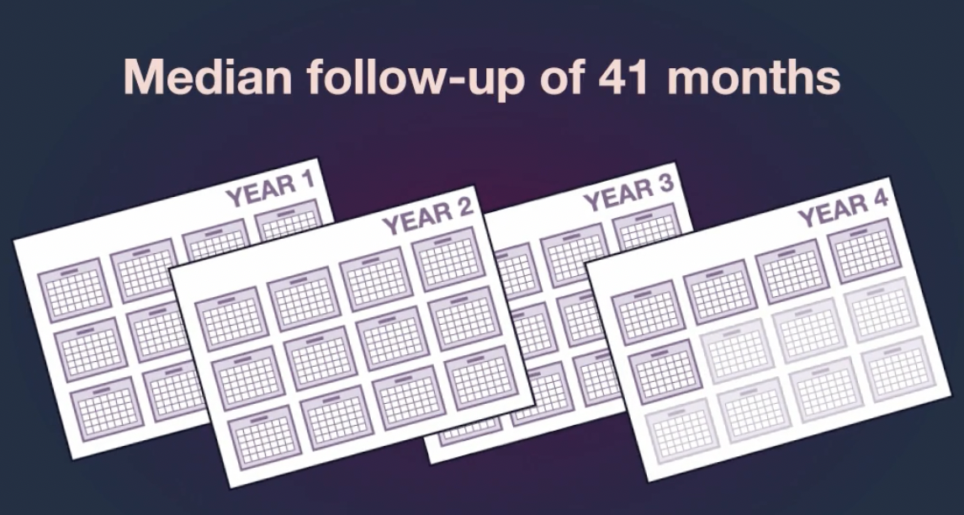
REVIVED-BCIS2 Trial
@ANazmiCalik
Perera D et al. Percutaneous Revascularization for Ischemic Left Ventricular Dysfunction.
N Engl J Med. 2022 Oct 13;387(15):1351-1360. doi: 10.1056/NEJMoa2206606.

Slide 19
REVIVED-BCIS2 Trial
@ANazmiCalik
Perera D et al. Percutaneous Revascularization for Ischemic Left Ventricular Dysfunction.
N Engl J Med. 2022 Oct 13;387(15):1351-1360. doi: 10.1056/NEJMoa2206606.

Slide 20
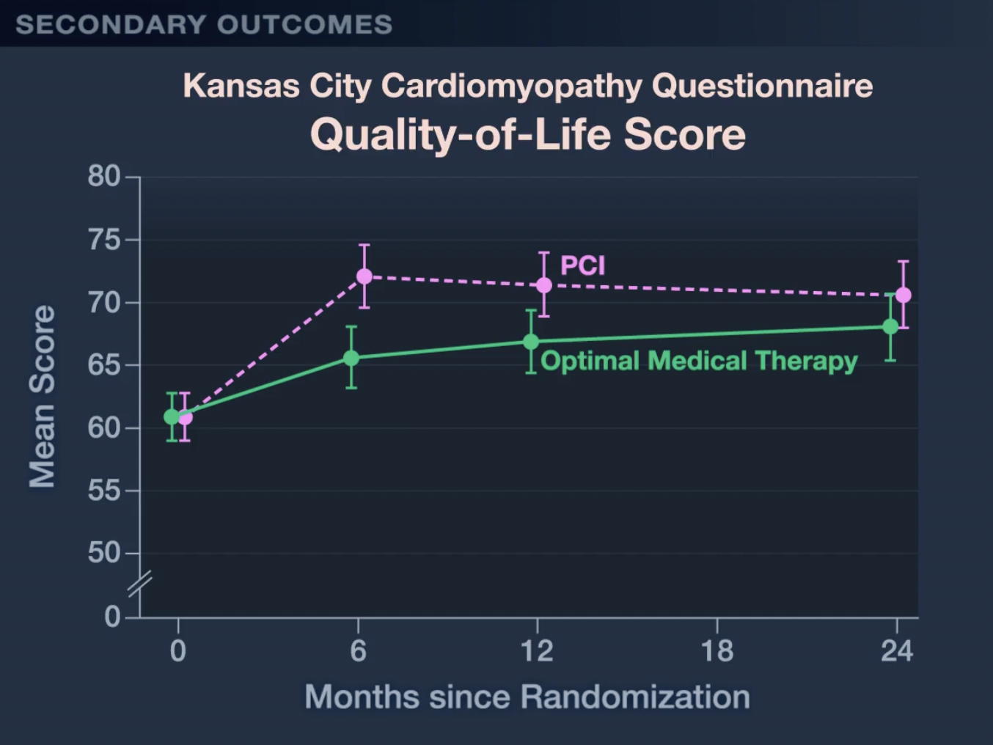
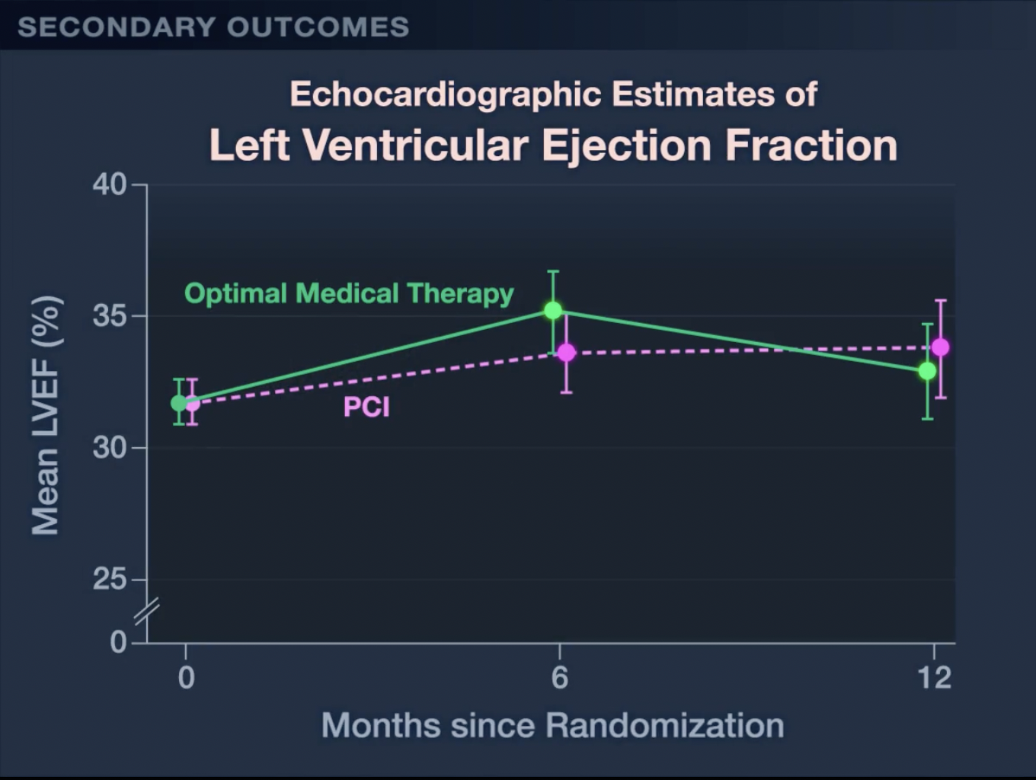
REVIVED-BCIS2 Trial
@ANazmiCalik
Perera D et al. Percutaneous Revascularization for Ischemic Left Ventricular Dysfunction.
N Engl J Med. 2022 Oct 13;387(15):1351-1360. doi: 10.1056/NEJMoa2206606.

Slide 21
REVIVED-BCIS2 Trial
@ANazmiCalik
Perera D et al. Percutaneous Revascularization for Ischemic Left Ventricular Dysfunction.
N Engl J Med. 2022 Oct 13;387(15):1351-1360. doi: 10.1056/NEJMoa2206606.

Slide 22
REVIVED-BCIS2 Trial
@ANazmiCalik
Perera D et al. Percutaneous Revascularization for Ischemic Left Ventricular Dysfunction.
N Engl J Med. 2022 Oct 13;387(15):1351-1360. doi: 10.1056/NEJMoa2206606.

Slide 23
REVIVED-BCIS2 Trial
Exclusion Criteria
Myocardial infarction <4 weeks prior to randomization
Acutely decompensated heart failure requiring inotropic support, invasive or non-invasive ventilation or mechanical circulatory assist therapy <72 hours prior to randomization
Sustained ventricular tachycardia/ventricular fibrillation or appropriate implantable cardioverter defibrillator discharges <72 hours prior to randomization
Valve disease deemed by the local heart team to require imminent intervention
@ANazmiCalik
Perera D et al. Percutaneous Revascularization for Ischemic Left Ventricular Dysfunction.
N Engl J Med. 2022 Oct 13;387(15):1351-1360. doi: 10.1056/NEJMoa2206606.

Slide 24
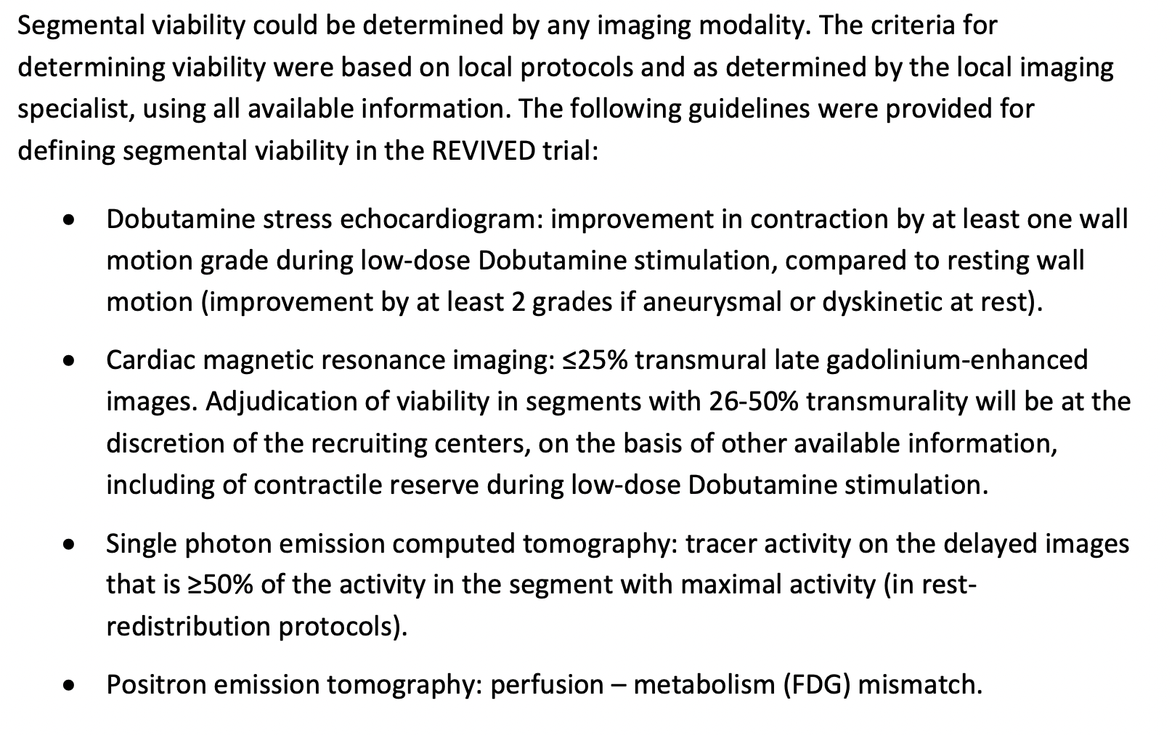
REVIVED-BCIS2 Trial
@ANazmiCalik
Perera D et al. Percutaneous Revascularization for Ischemic Left Ventricular Dysfunction.
N Engl J Med. 2022 Oct 13;387(15):1351-1360. doi: 10.1056/NEJMoa2206606.

Slide 25
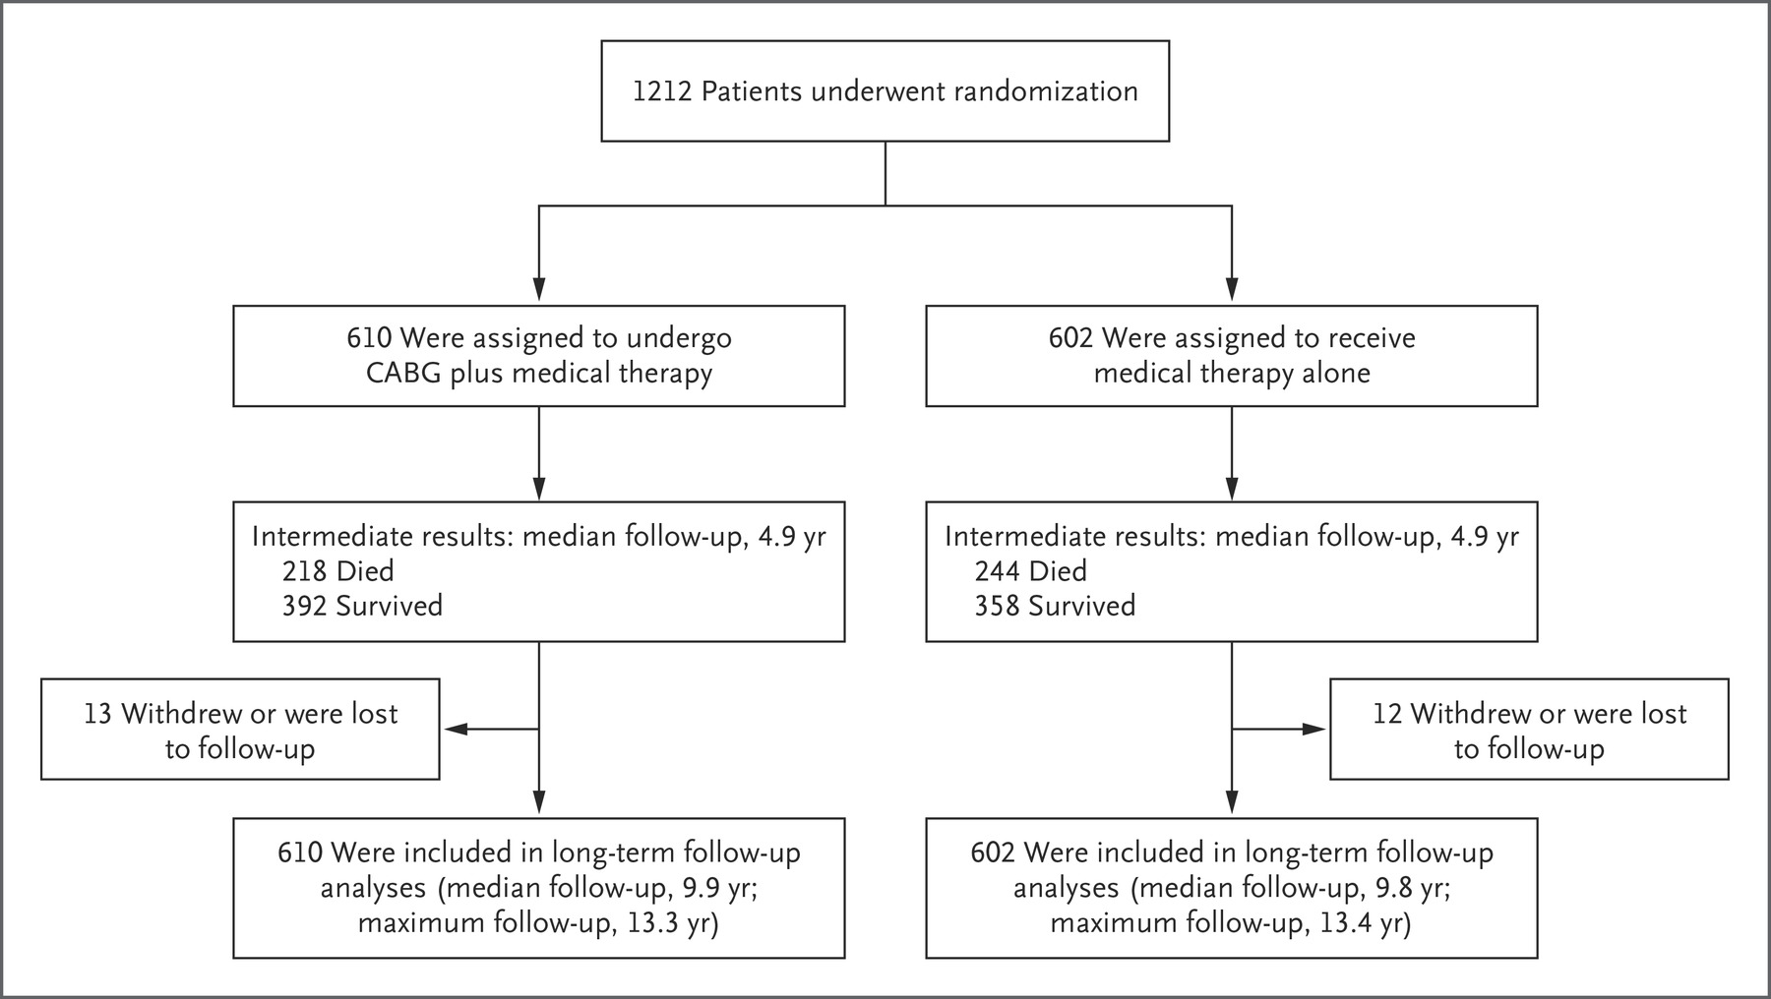
STICHES: EF <35% - CABG + OMT vs OMT
@ANazmiCalik
Velazquez EJ et al. STICHES Investigators. Coronary-Artery Bypass Surgery in Patients with Ischemic Cardiomyopathy.
N Engl J Med. 2016 Apr 21;374(16):1511-20. doi: 10.1056/NEJMoa1602001.

Slide 26
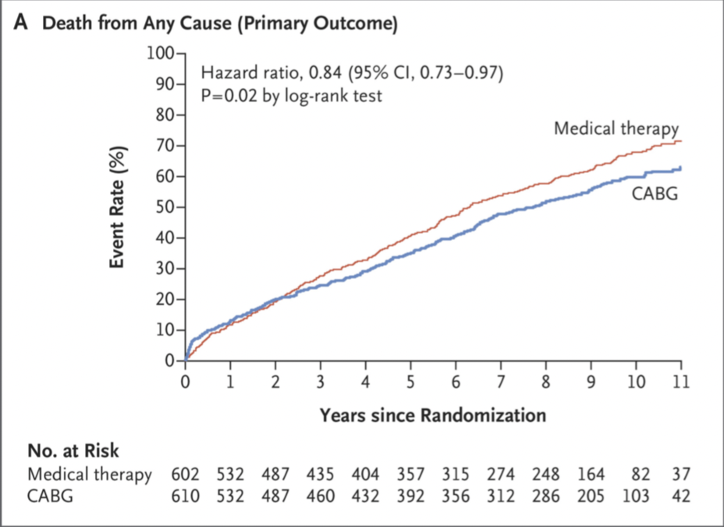
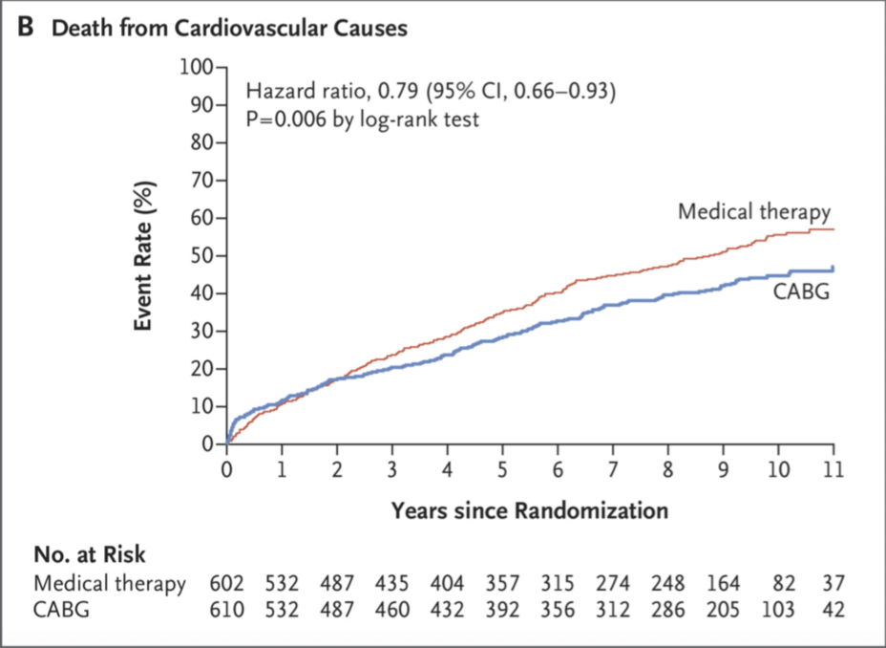
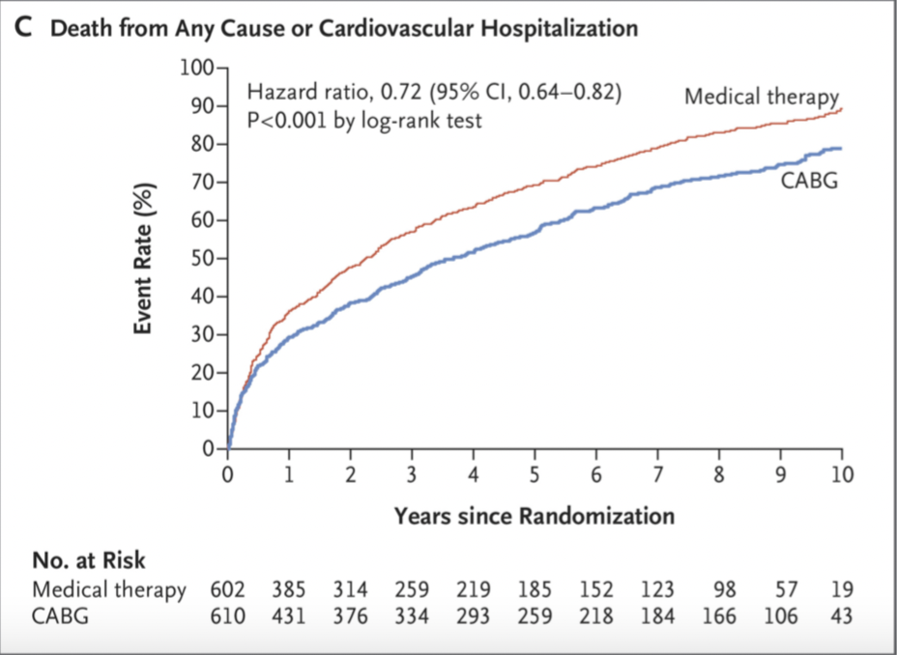
STICHES: 10 year outcome
@ANazmiCalik
Velazquez EJ et al. STICHES Investigators. Coronary-Artery Bypass Surgery in Patients with Ischemic Cardiomyopathy.
N Engl J Med. 2016 Apr 21;374(16):1511-20. doi: 10.1056/NEJMoa1602001.

Slide 27
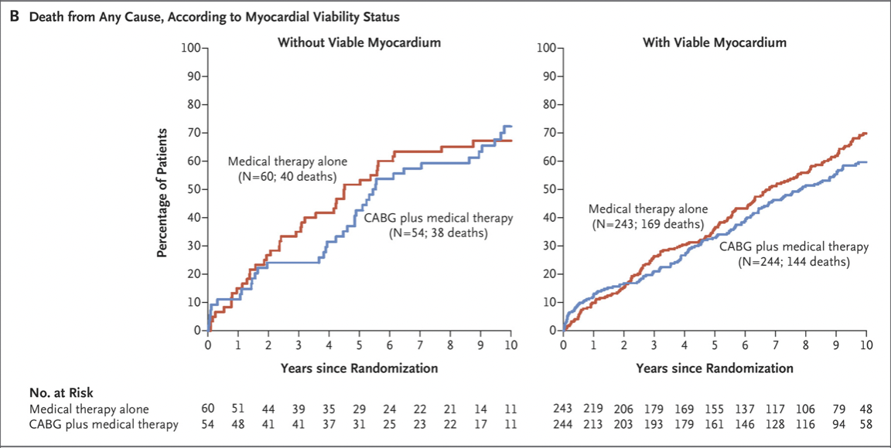
STICH viability sub-study: 10 y outcome
@ANazmiCalik
Panza JA et al. Myocardial Viability and Long-Term Outcomes in Ischemic Cardiomyopathy.
N Engl J Med. 2019 Aug 22;381(8):739-748. doi: 10.1056/NEJMoa1807365.

Slide 28
STICH viability sub-study: 10 y outcome
@ANazmiCalik
Panza JA et al. Myocardial Viability and Long-Term Outcomes in Ischemic Cardiomyopathy.
N Engl J Med. 2019 Aug 22;381(8):739-748. doi: 10.1056/NEJMoa1807365.

Slide 29
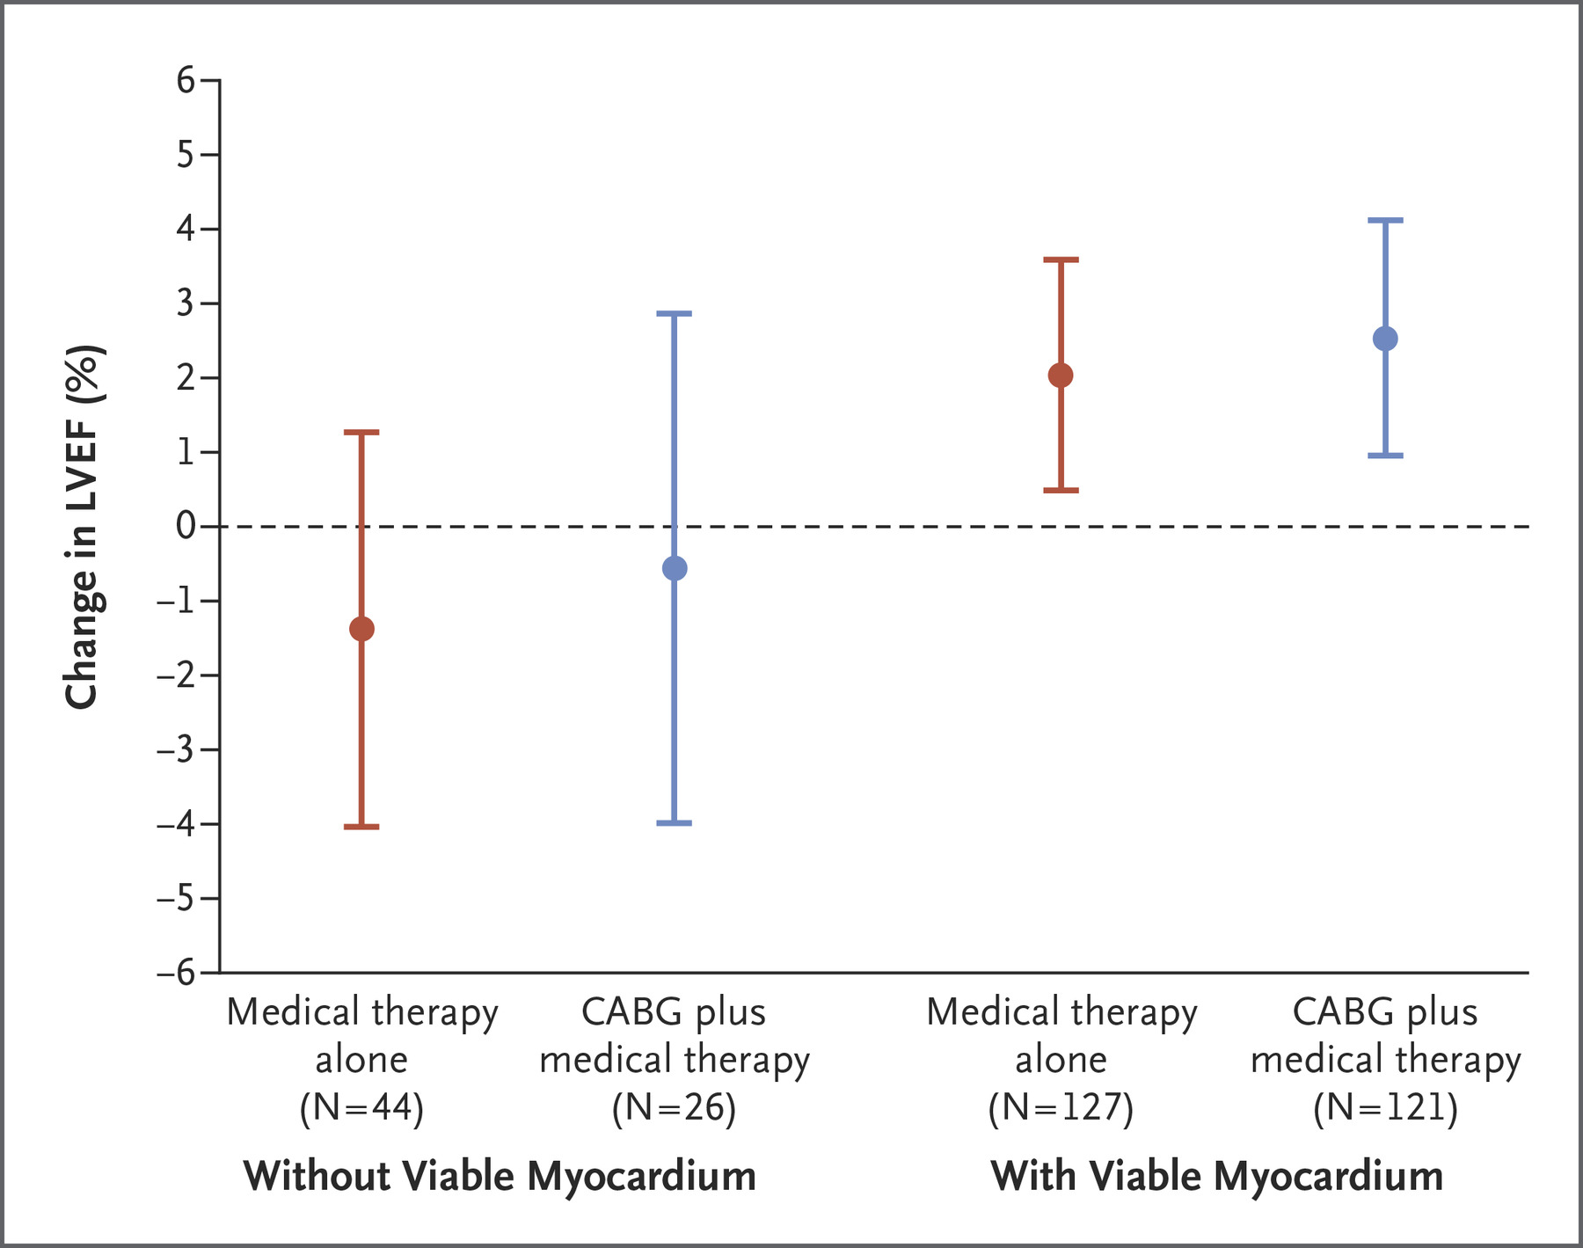
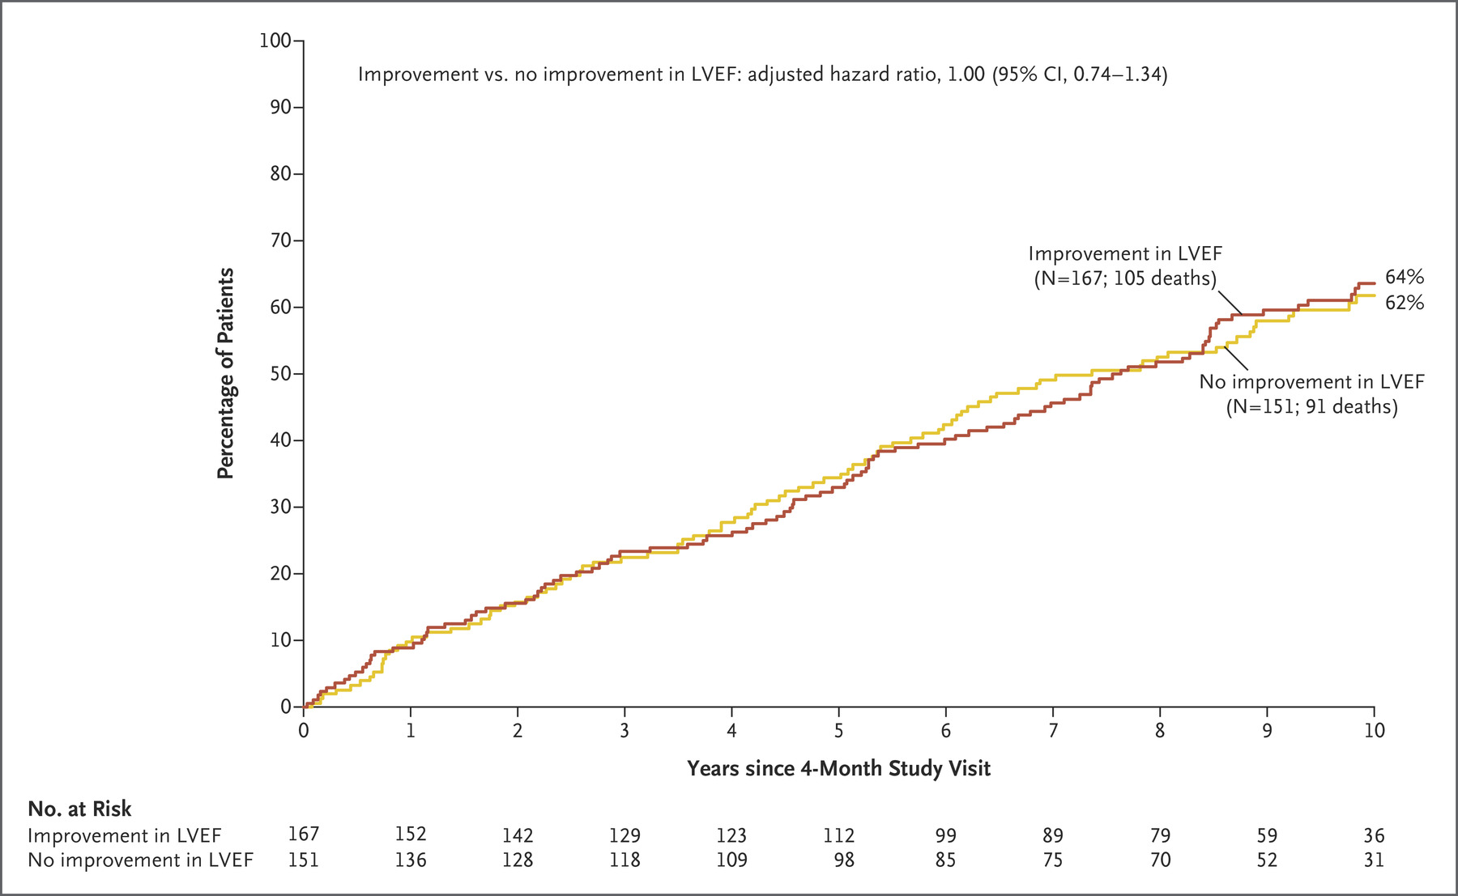
STICH viability sub-study: 10 y outcome
@ANazmiCalik
Panza JA et al. Myocardial Viability and Long-Term Outcomes in Ischemic Cardiomyopathy.
N Engl J Med. 2019 Aug 22;381(8):739-748. doi: 10.1056/NEJMoa1807365.

Slide 30
REVIVED-BCIS2 + STICH viability sub-study
Best treatment decision for each patient
Viable myocardium
Anatomical extent of coronary and myocardial disease
Regional correspondence between LV dysfunction and
the likelihood of successful revascularization of the corresponding coronary arteries
@ANazmiCalik

Slide 31
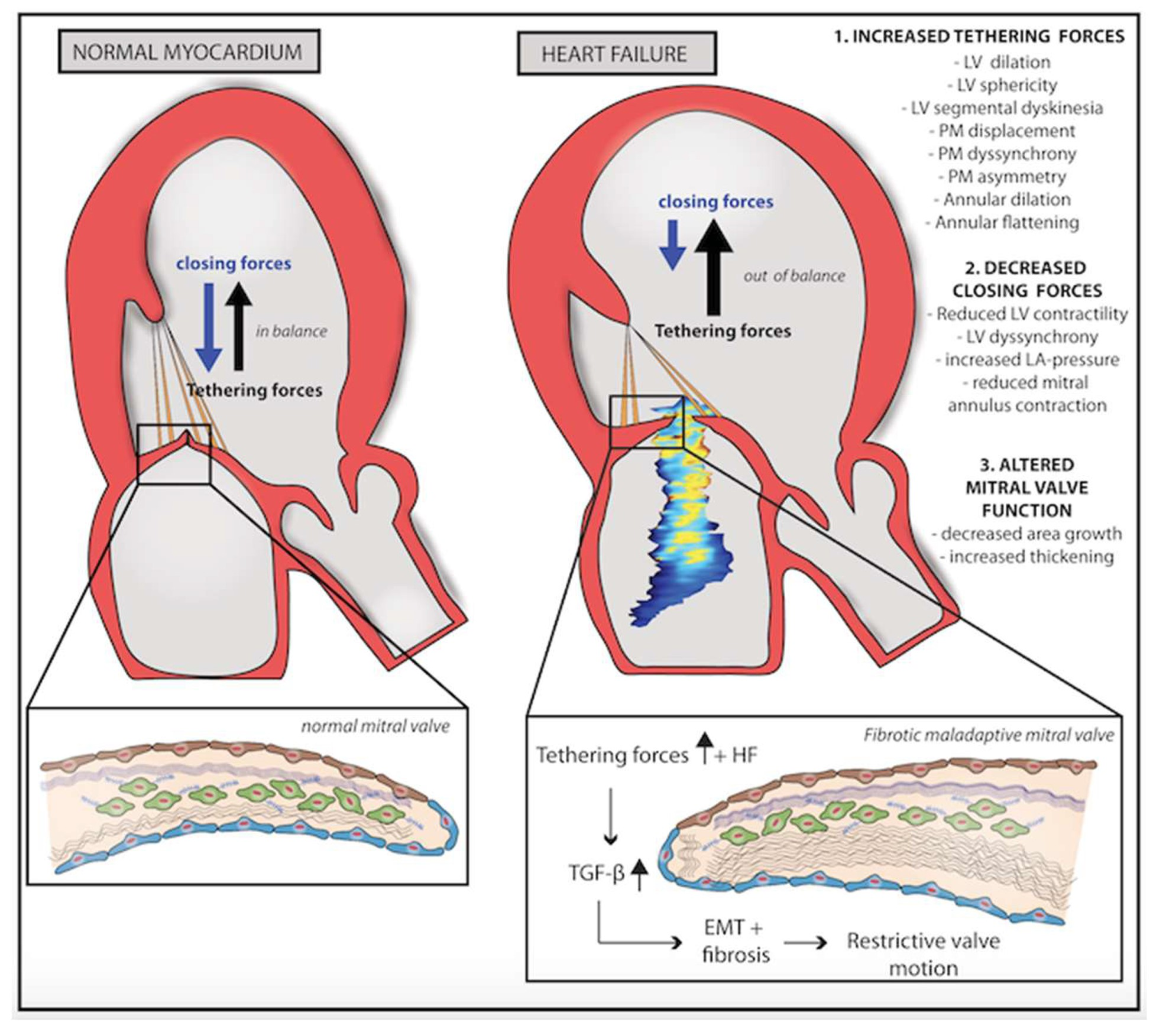
Secondary or functional MR
@ANazmiCalik
Coats AJS et al. The management of secondary mitral regurgitation in patients with heart failure:
Eur Heart J. 2021 Mar 31;42(13):1254-1269. doi: 10.1093/eurheartj/ehab086.

Slide 32
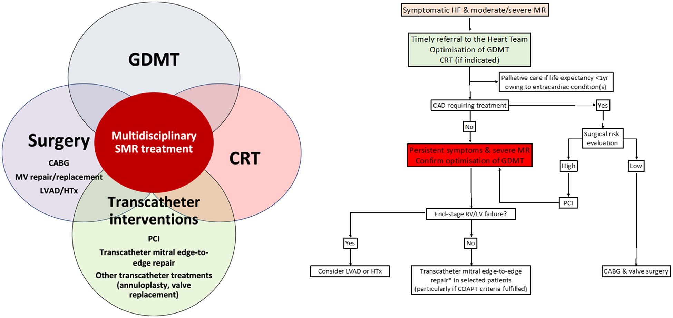
Secondary or functional MR
@ANazmiCalik
Coats AJS et al. The management of secondary mitral regurgitation in patients with heart failure:
Eur Heart J. 2021 Mar 31;42(13):1254-1269. doi: 10.1093/eurheartj/ehab086.

Slide 33
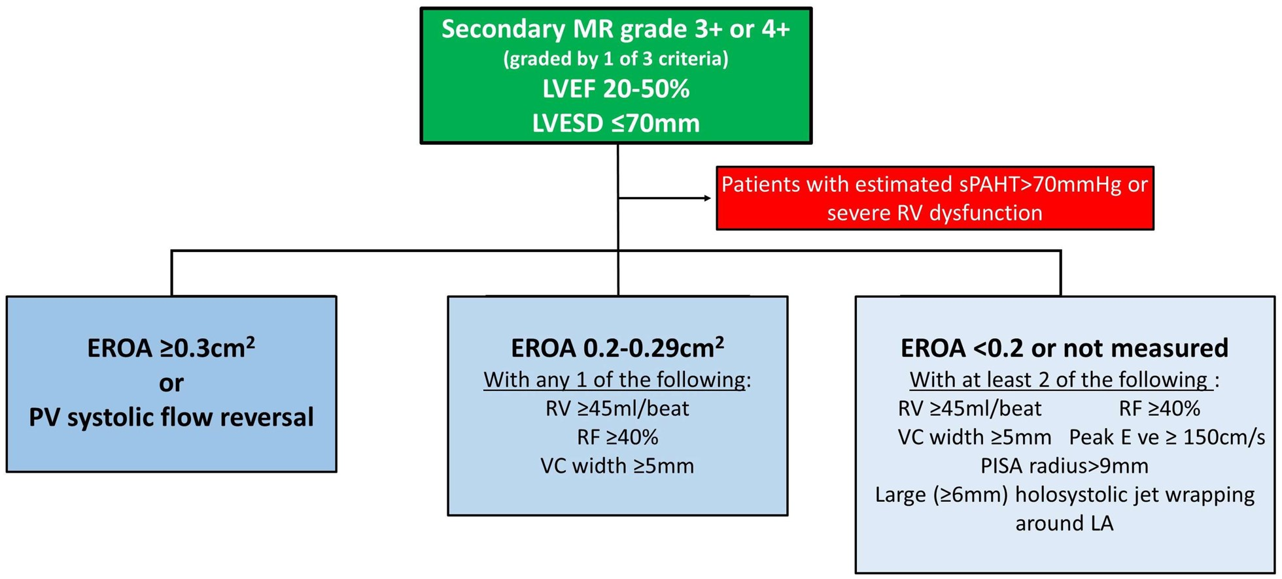
Secondary or functional MR – COAPT criteria
@ANazmiCalik
Coats AJS et al. The management of secondary mitral regurgitation in patients with heart failure:
Eur Heart J. 2021 Mar 31;42(13):1254-1269. doi: 10.1093/eurheartj/ehab086.

Slide 34
TEER - MitraClip
@ANazmiCalik
The PCR & EAPCI Textbook

Slide 35
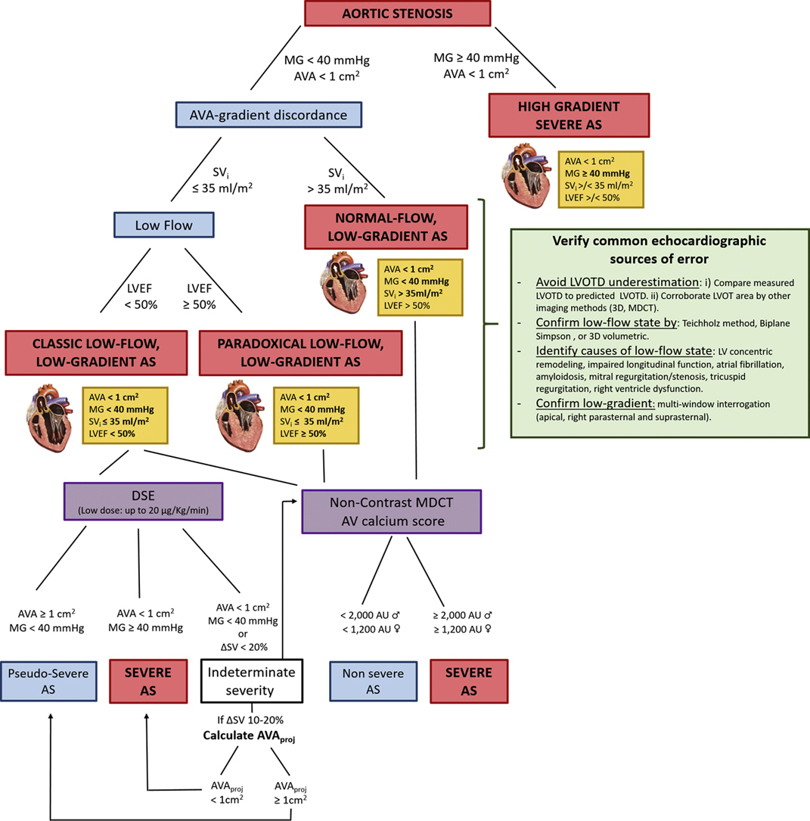
Severe aortic stenosis
@ANazmiCalik
Iria Silva et al. J Am Coll Cardiol Case Rep 2022; 4:170-177.

Slide 36
Severe aortic stenosis
@ANazmiCalik
Iria Silva et al. J Am Coll Cardiol Case Rep 2022; 4:170-177.

Slide 37
Severe aortic stenosis
@ANazmiCalik
Iria Silva et al. J Am Coll Cardiol Case Rep 2022; 4:170-177.

Slide 38
Severe aortic stenosis
@ANazmiCalik
Iria Silva et al. J Am Coll Cardiol Case Rep 2022; 4:170-177.

Slide 39
Severe aortic stenosis
@ANazmiCalik
Iria Silva et al. J Am Coll Cardiol Case Rep 2022; 4:170-177.

Slide 40
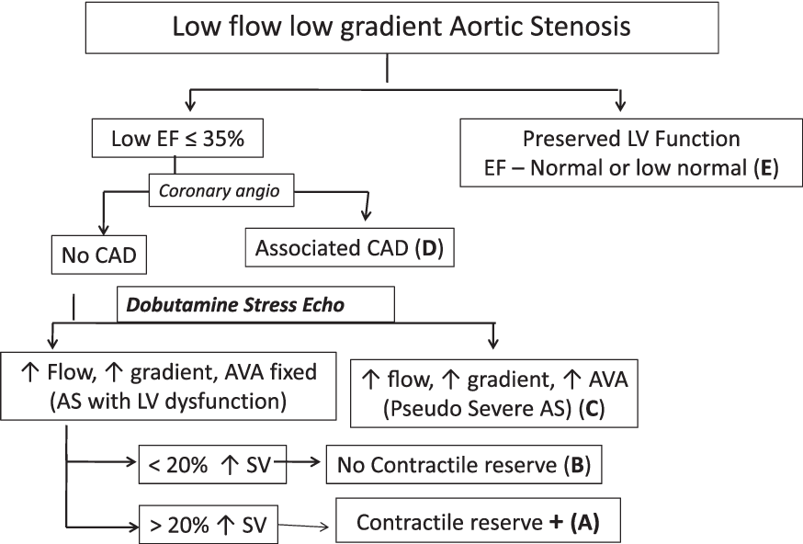
Severe aortic stenosis
@ANazmiCalik

Slide 41
The role of imaging in HFrEF
@ANazmiCalik
Gosling RC, Al-Mohammad A. The Role of Cardiac Imaging in Heart Failure with Reduced Ejection Fraction. Card Fail Rev. 2022 Jun 24;8:e22.

Slide 42
Diqqətinizə görə təşəkkürlər
Diqqətinizə görə təşəkkürlər…
@ANazmiCalik

Slide 43
Why is it important?
@ANazmiCalik

